Slide 1
Fake Detect

Slide 2
Data Overview
Obama
 | # of Videos | Video Length (s) | Total # of Frames
Train Positive | 80 | 7118 | 207994
Train Negative | 500 | 3681 | 101819
Test Positive | 76 | 6720 | 196541
Test Negative (Generated Fake Video) | 117 | 2791 | 283916
Test Negative (Impersonator Video) | 2 | 417 | 12707
Test Negative (Politician Video) | 6 | 9509 | 194990
Trump
 | # of Videos | Video Length (s) | Total # of Frames
Train Positive | 14 | 1207 | 35257
Train Negative | 197 | 3681 | 101819
Test Positive | 12 | 1027 | 23838
Test Negative (Generated Fake Video) | 73 | 1184 | 121328
Test Negative (Politician Video) | 6 | 9509 | 194990

Slide 3
Feature Analysis Test Negative: generated fake videos [FaceSwap using targets’ masks]
Sequence = 100 Frame, Overlap = 10 Frame
 | Trump | Obama
All Feature | 0.658025 | 0.30054
Location of the head wrt camera | 0.676117 | 0.29845
Head rotation | 0.819682 | 0.465786
Lip gap/width | 0.984704 | 0.992473
Eye gaze direction | 0.682071 | 0.892383
Eye blink | 0.703402 | 0.875203

Slide 4
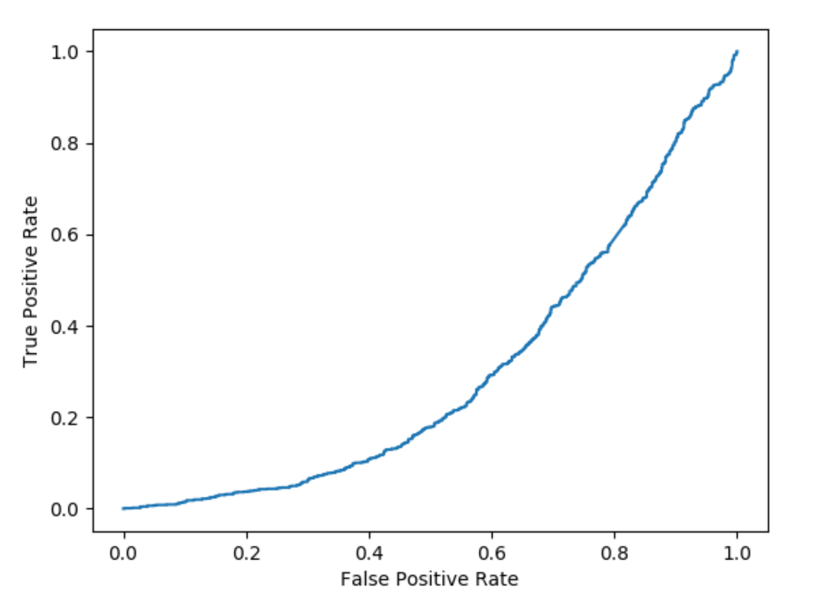
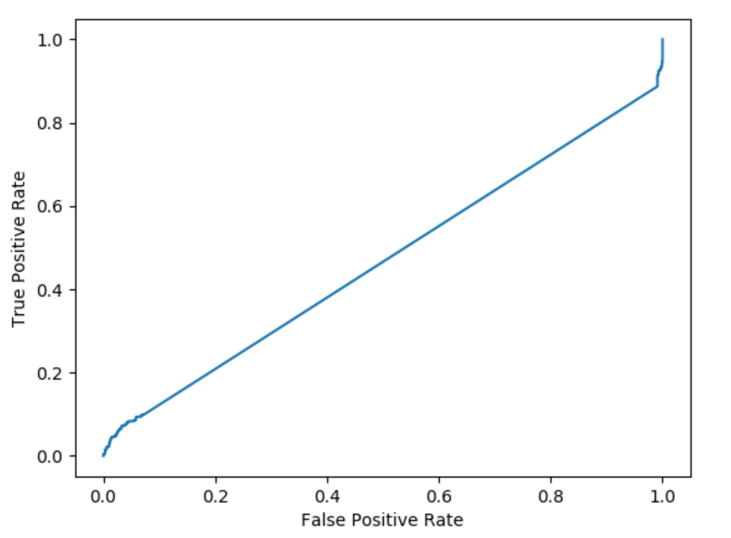
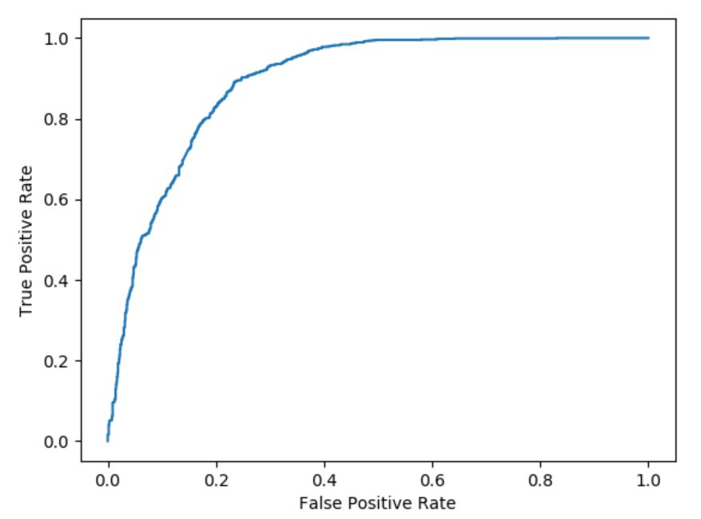
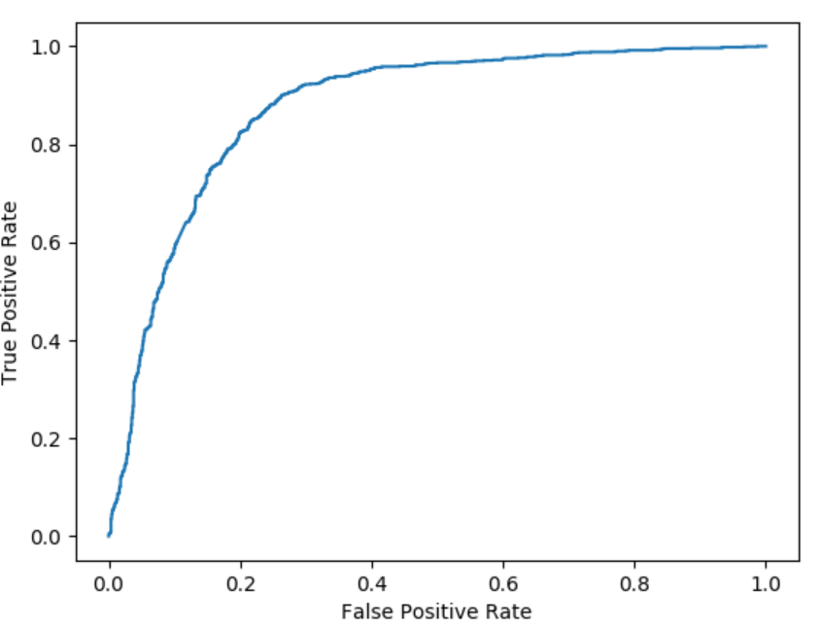
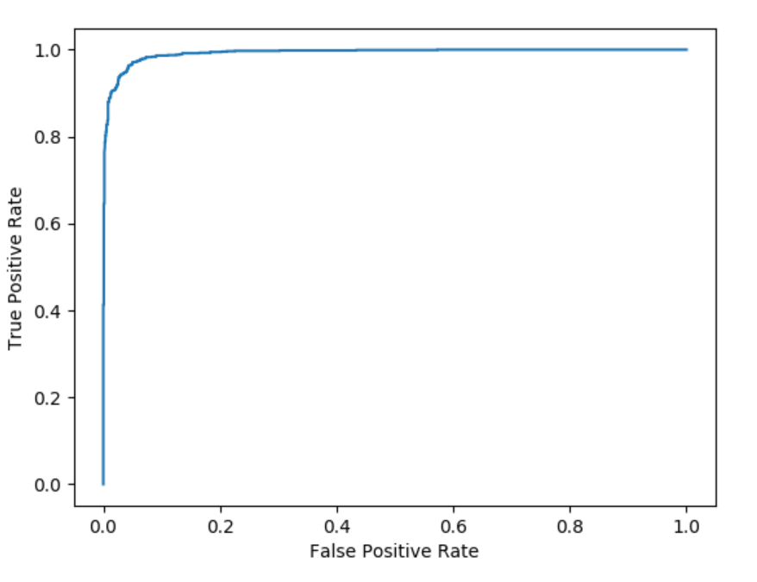
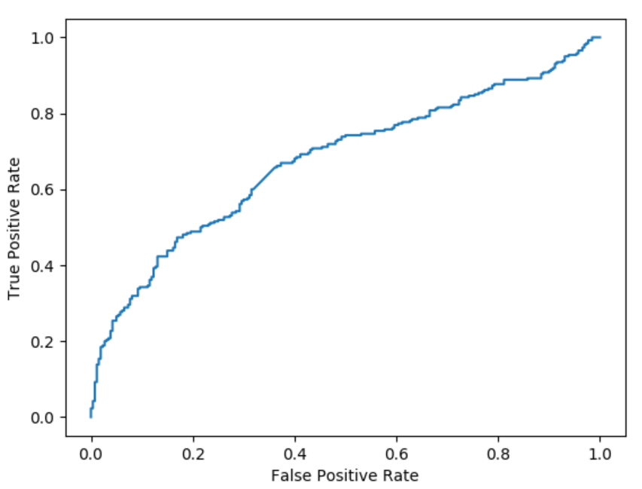
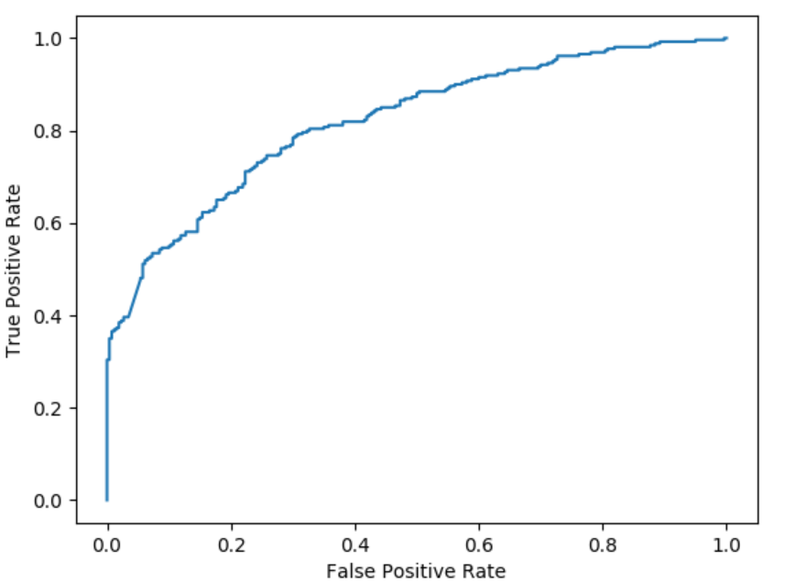
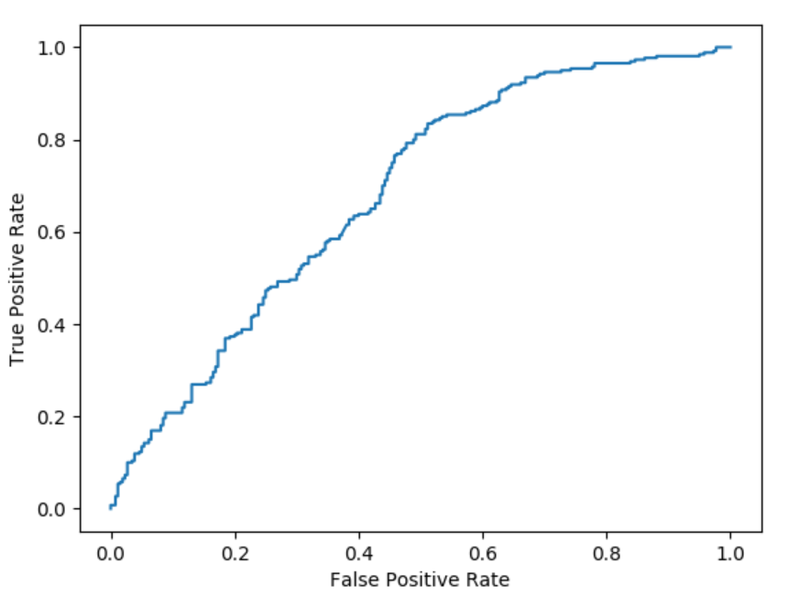
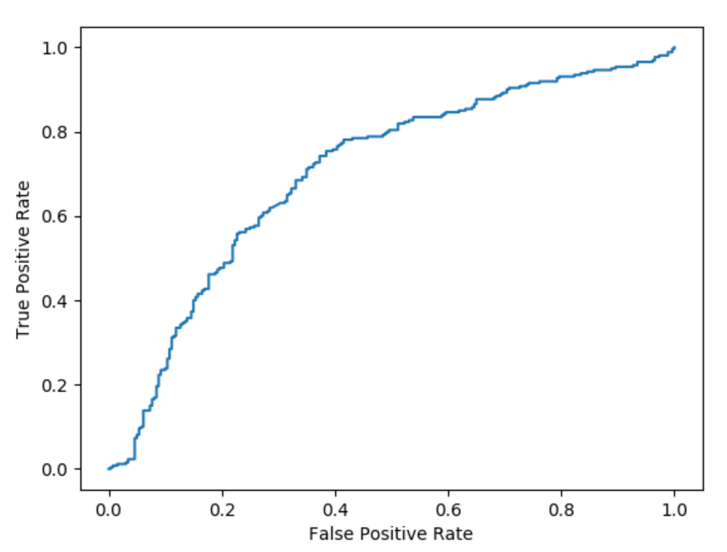
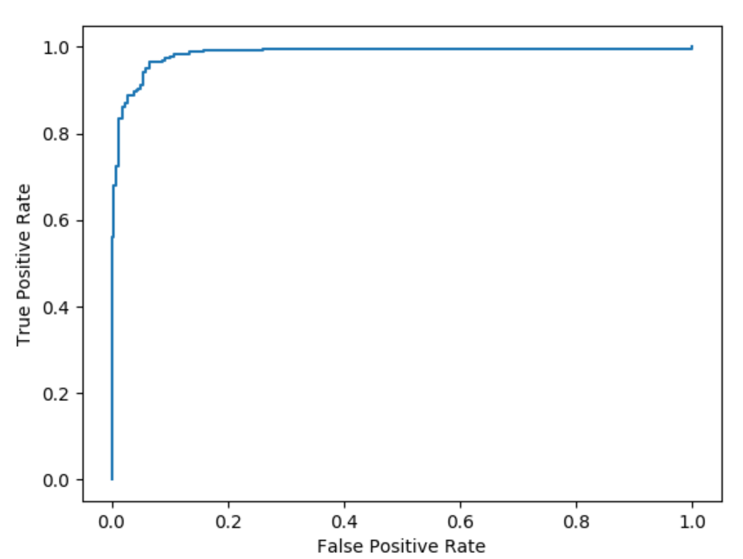
Feature Analysis Sequence = 100 Frame, Overlap = 10 Frame Test Negative: Generated fake videos using targets’ (Obama/Trump) faces as masks
Head wrt. Camera | Head Rotation | Gaze | Blink | Lips
Obama
Trump

Slide 5
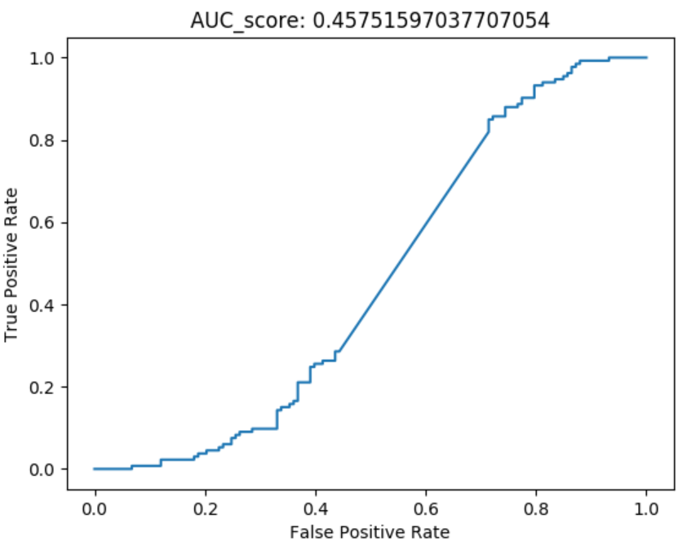
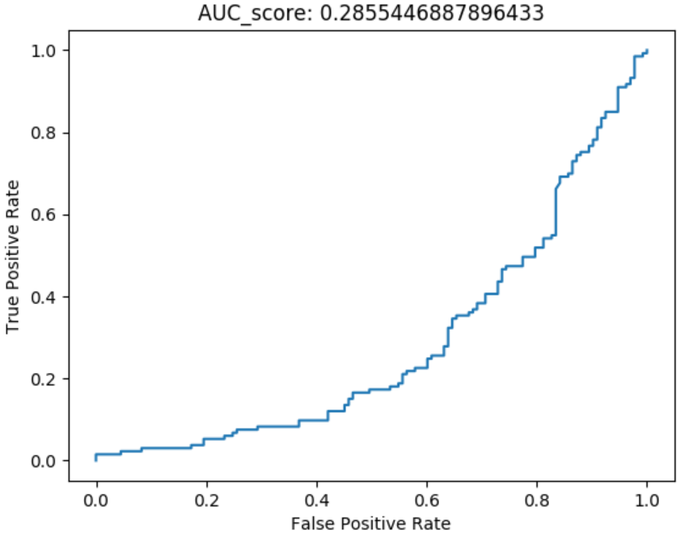
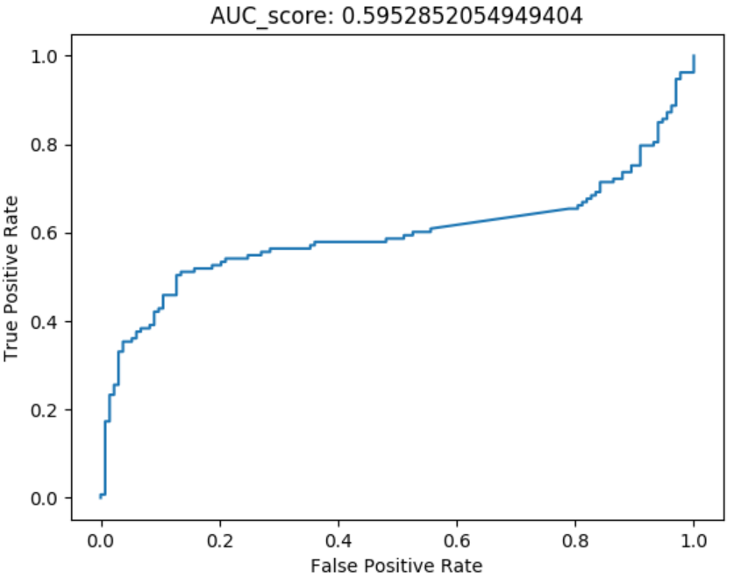
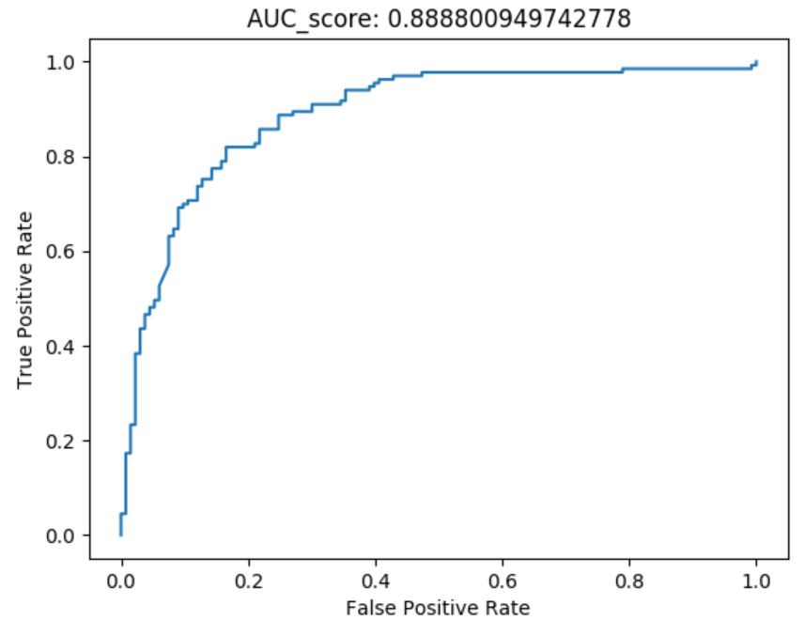
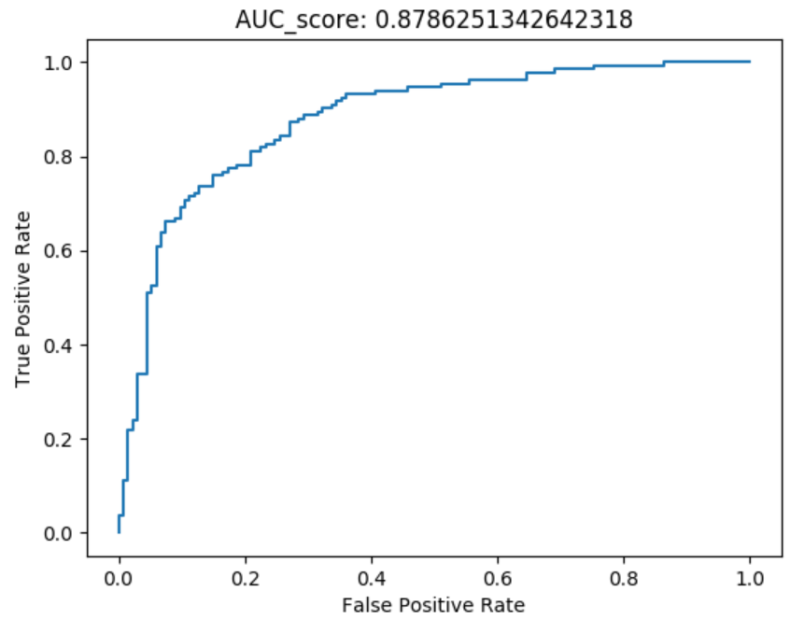
Feature Analysis Sequence = 100 Frame, Overlap = 10 Frame Test Negative: Generated fake videos with Obama mask vs. Obama Impersonator
Head wrt. Camera | Head Rotation | Gaze | Blink | Lips
FaceSwap Fake Videos for Obama
Obama Impostor

Slide 6
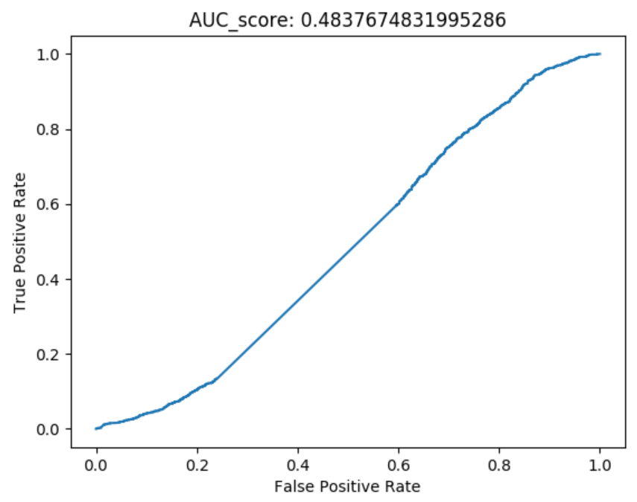
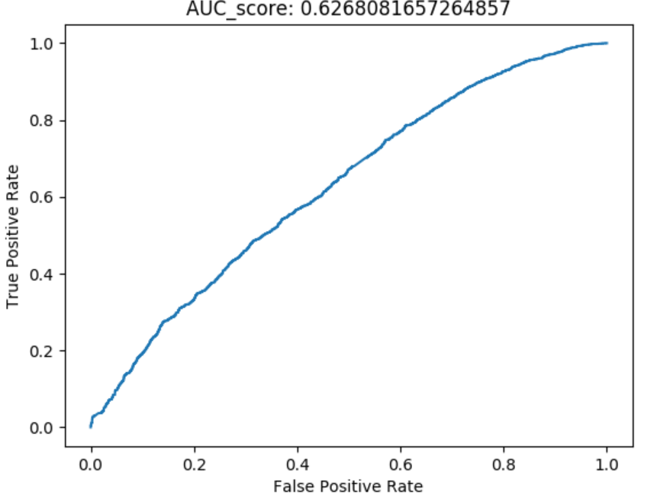
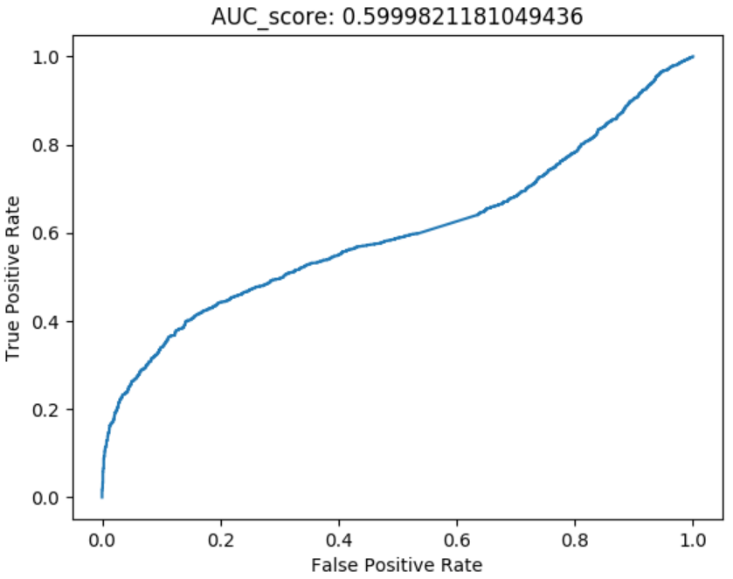
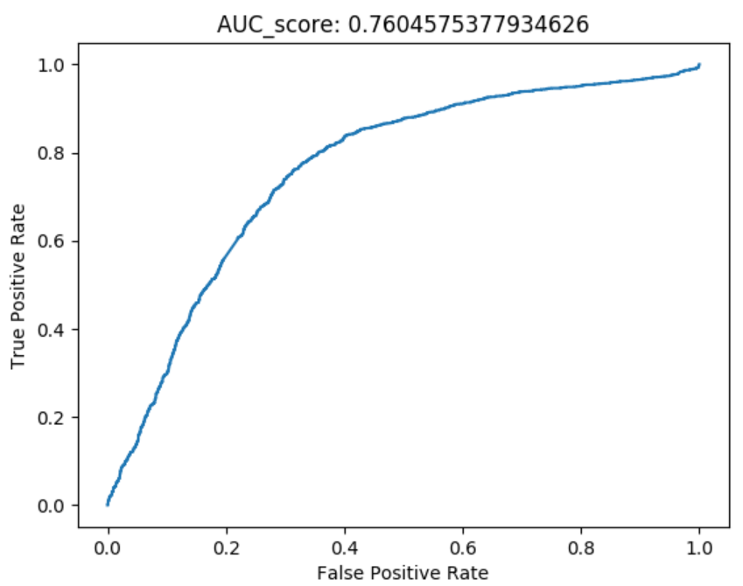

Feature Analysis Sequence = 100 Frame, Overlap = 10 Frame Test Negative: Generated fake videos with Obama mask vs. Other Politician(Hillary)
Head wrt. Camera | Head Rotation | Gaze | Blink | Lips
FaceSwap Fake Videos for Obama
Other Politician (Hillary)

Slide 7
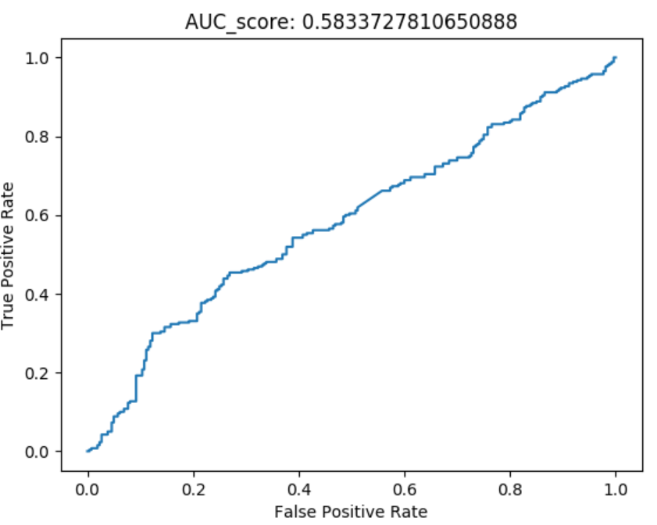
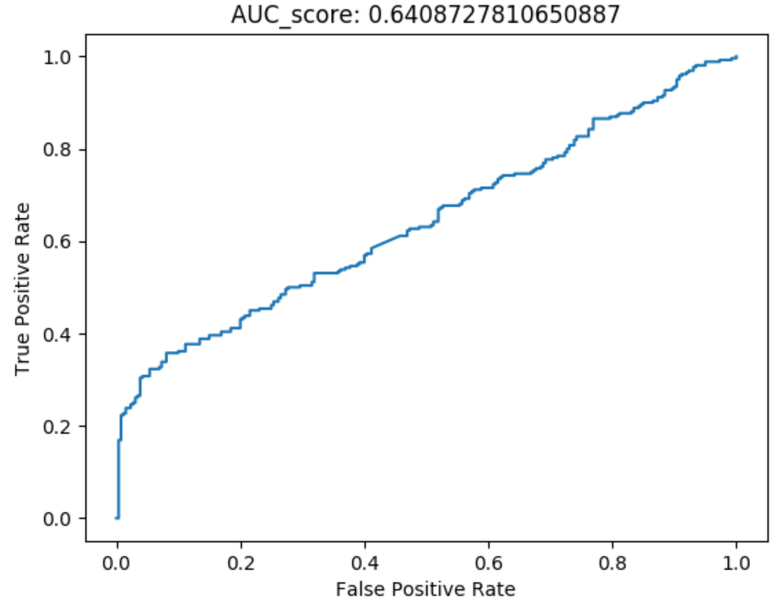
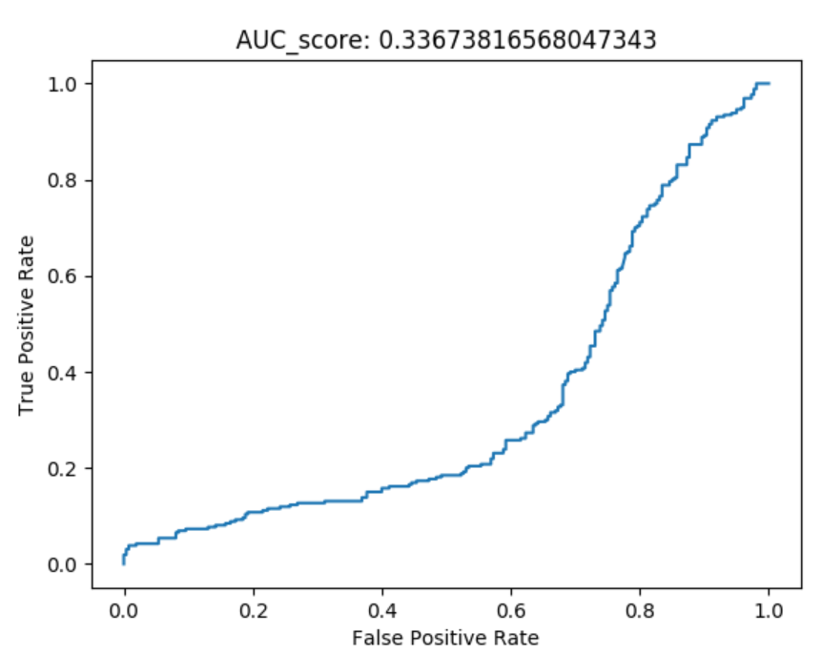
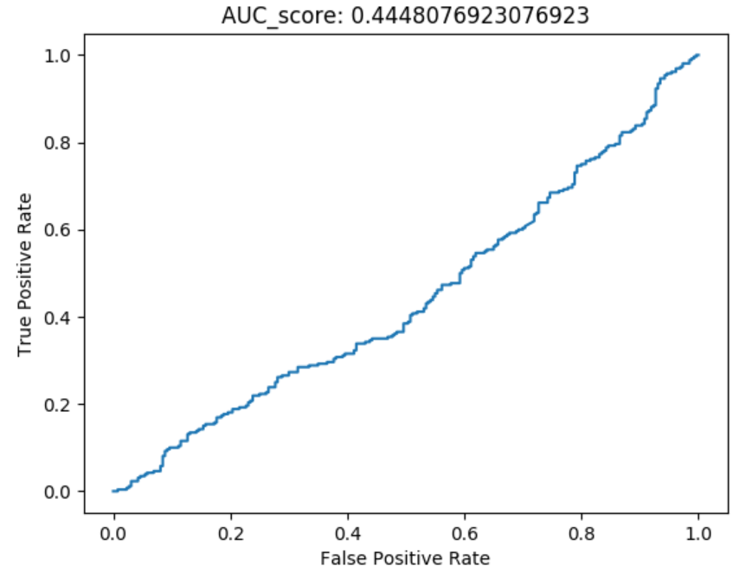
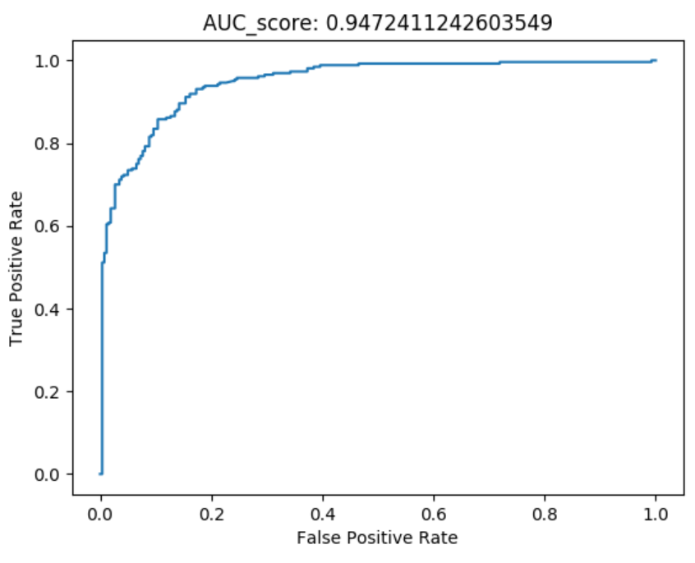
Feature Analysis Sequence = 100 Frame, Overlap = 10 Frame Test Negative: Generated fake videos with Trump mask vs. Other Politician(Hillary)
Head wrt. Camera | Head Rotation | Gaze | Blink | Lips
FaceSwap Fake Videos for Trump
Other Politician (Hillary)

Slide 8
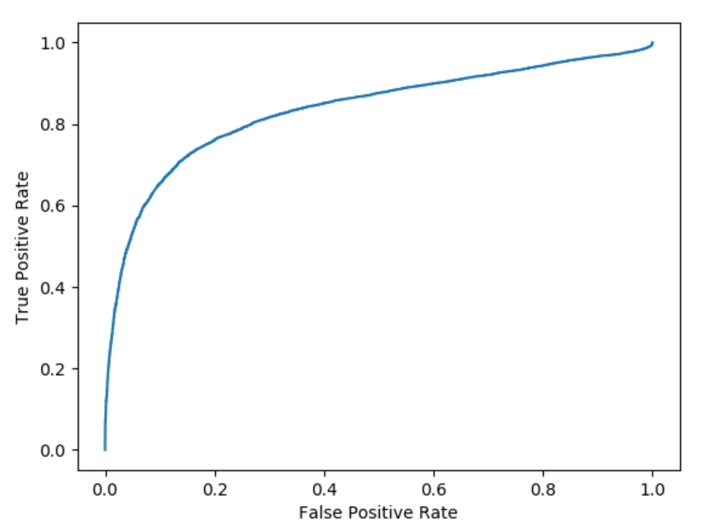
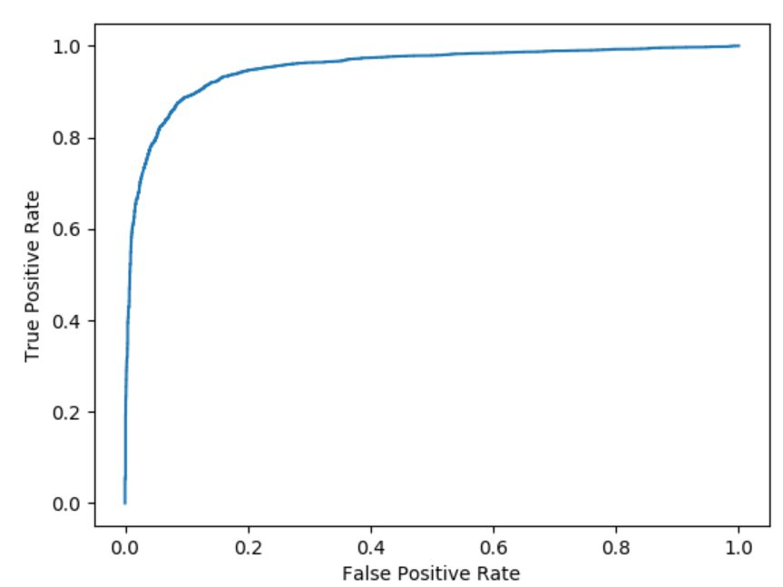
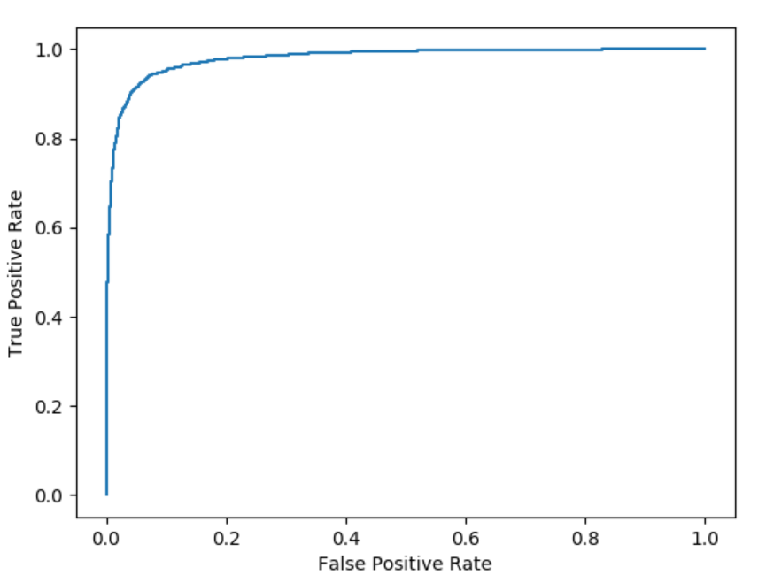
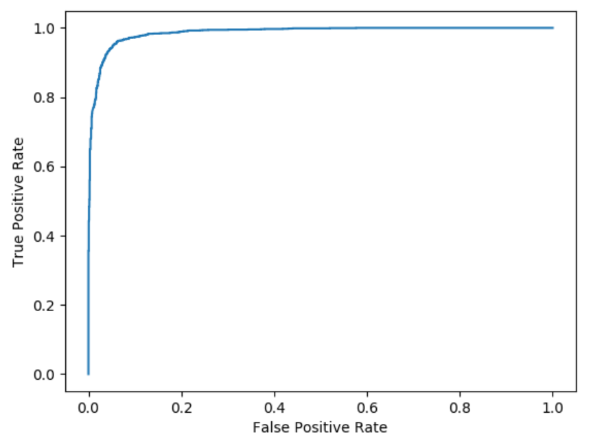
Frame Length Analysis Test Negative: generated fake videos [FaceSwap using targets’ masks] Trump, with Lips feature only
Frame | Overlap | Accuracy
10 | 1 | 0.834136
30 | 3 | 0.952445
50 | 5 | 0.979988
70 | 7 | 0.98664519
100 | 10 | 0.992473
Frame | 10 | 30 | 50 | 70 | 100
Overlap | 1 | 3 | 5 | 7 | 10

Slide 9
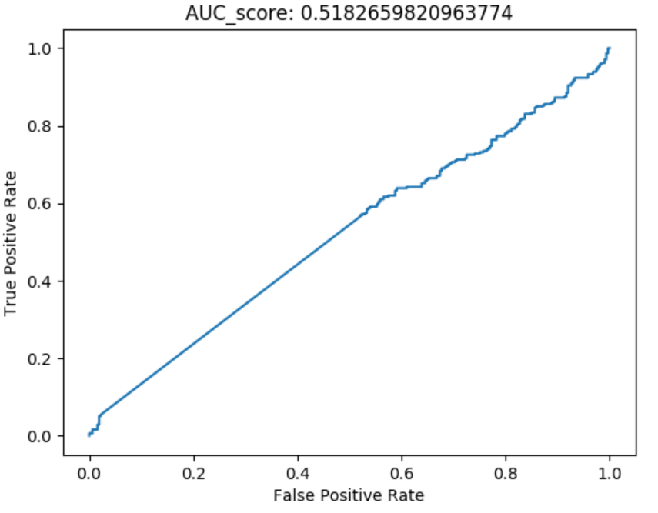
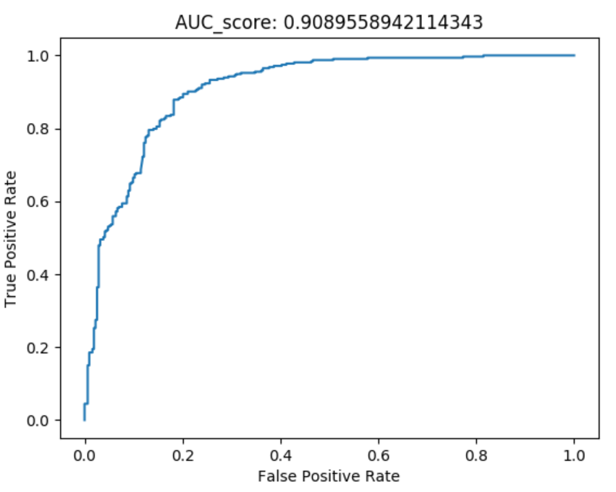
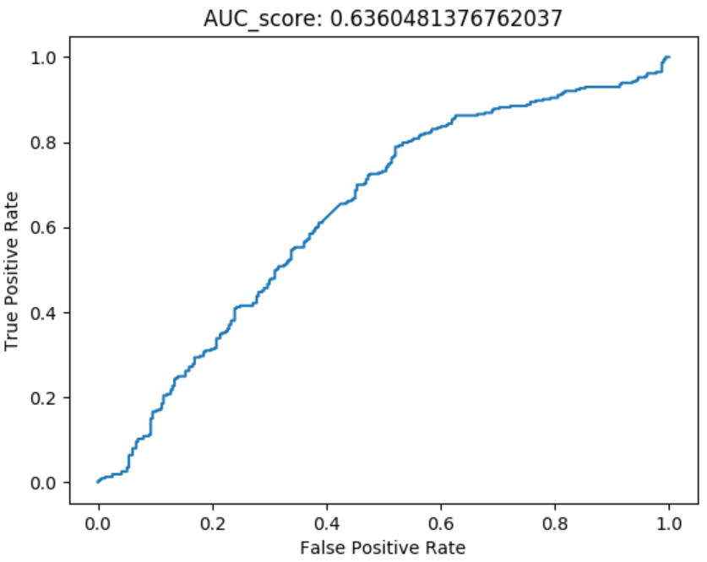
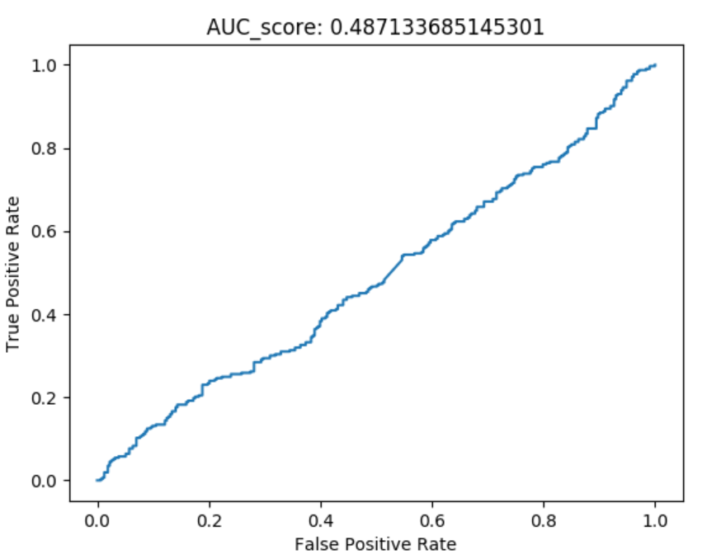
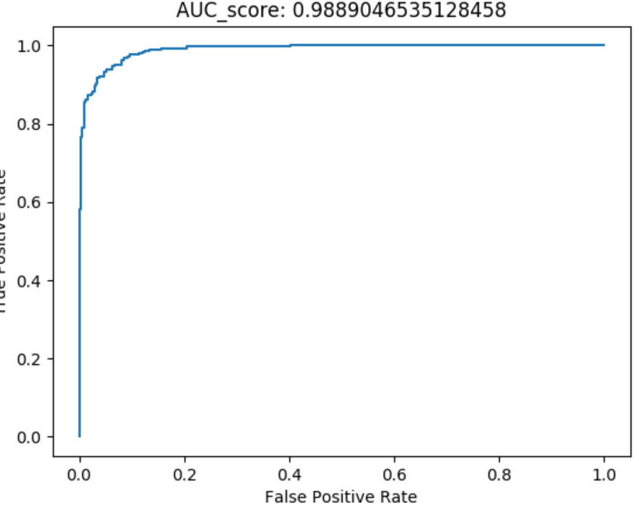
Image Quality Analysis Sequence = 100 Frame, Overlap = 10 Frame Test Positive: real Obama videos vs. Compressed real videos Test Negative: Generated fake videos with Obama mask vs. Compressed Fake Video Compression Method: Bitrate reduced to 300kps
Head wrt. Camera | Head Rotation | Gaze | Blink | Lips
FaceSwap Fake Videos for Obama
Compressed Fake Video for Obama Bitrate = 300Kbps

Slide 10
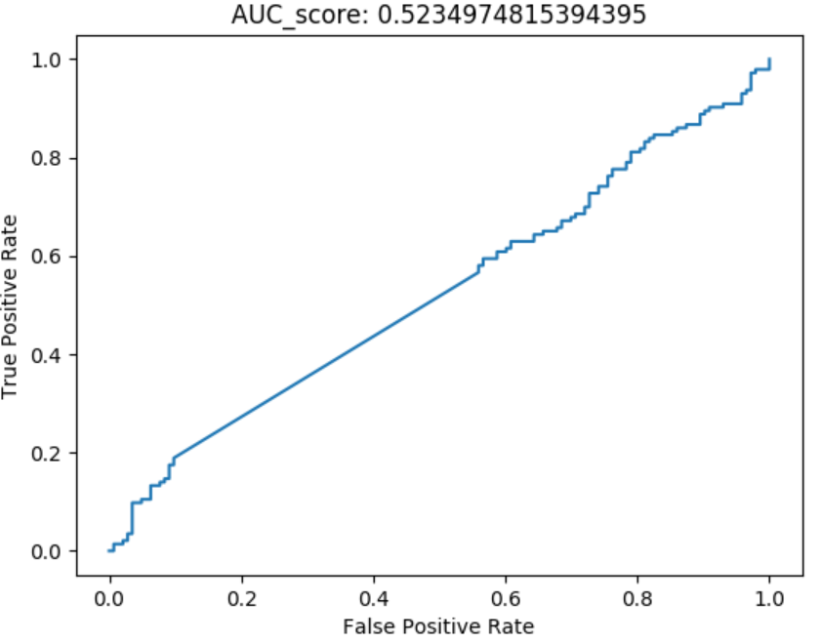
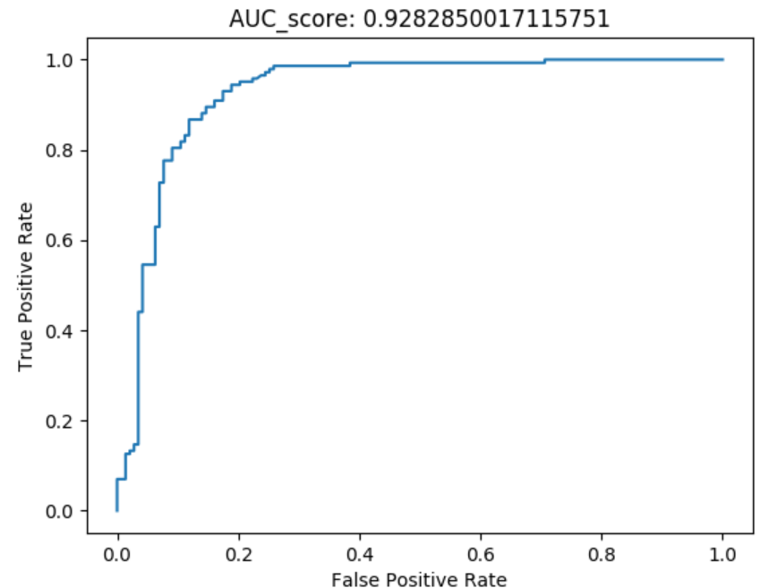
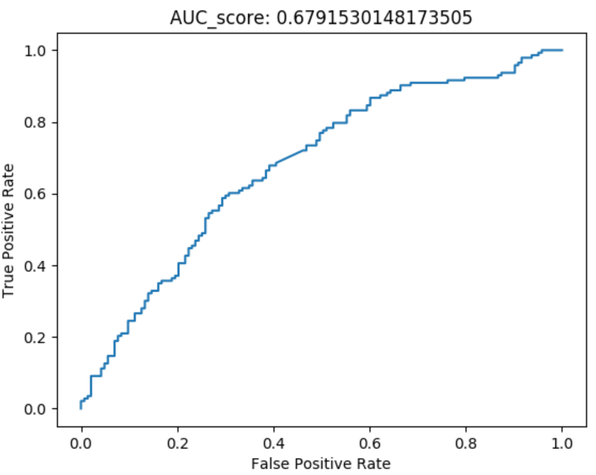
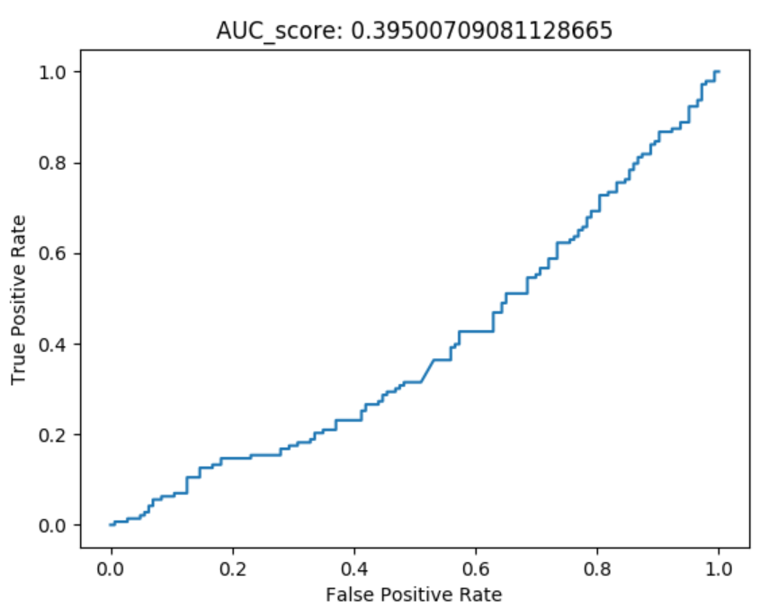
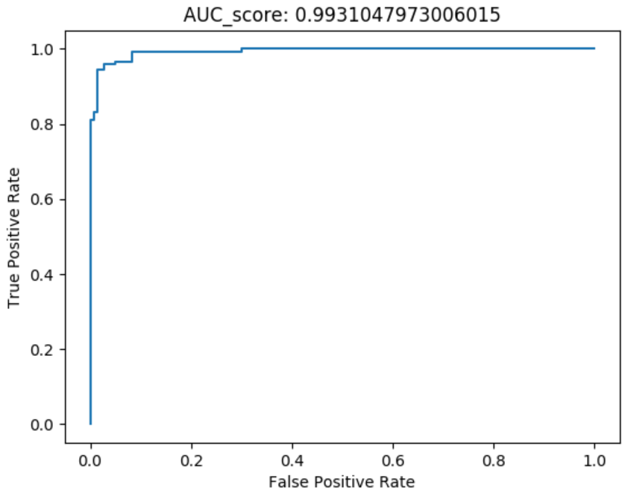
Image Quality Analysis Sequence = 100 Frame, Overlap = 10 Frame Test Positive: real Obama videos vs. Compressed real videos Test Negative: Generated fake videos with Obama mask vs. Compressed Fake Video Compression Method: Frame Rate reduced to ½ of original
Head wrt. Camera | Head Rotation | Gaze | Blink | Lips
FaceSwap Fake Videos for Obama
Compressed Fake Video for Obama ½ Frame Rate

Slide 11
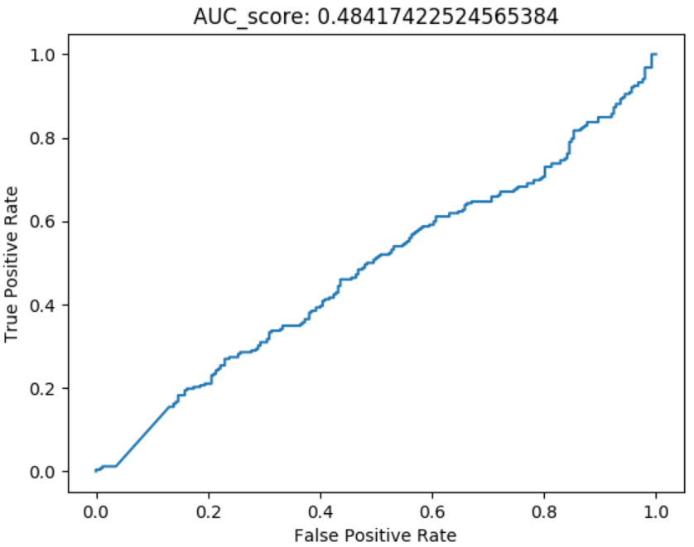
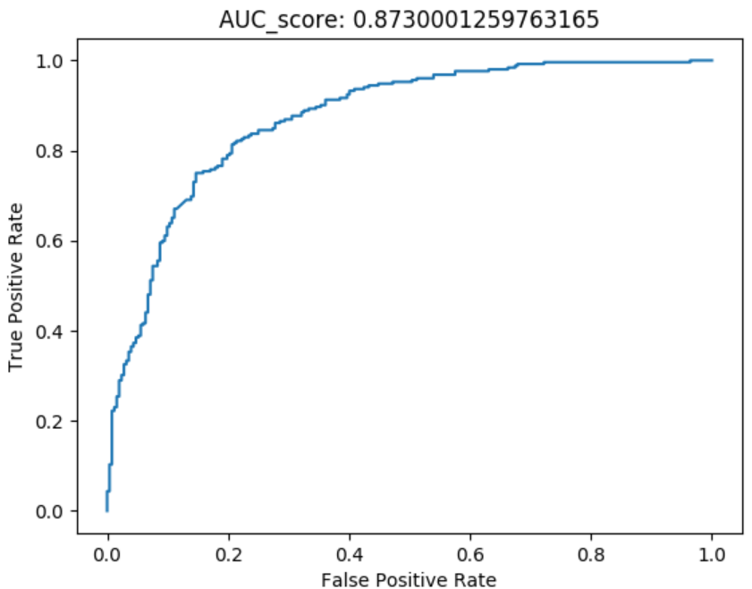
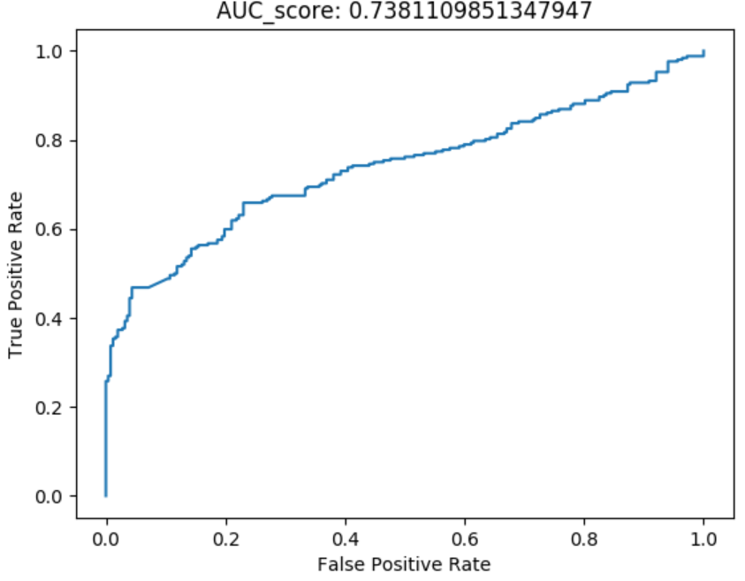
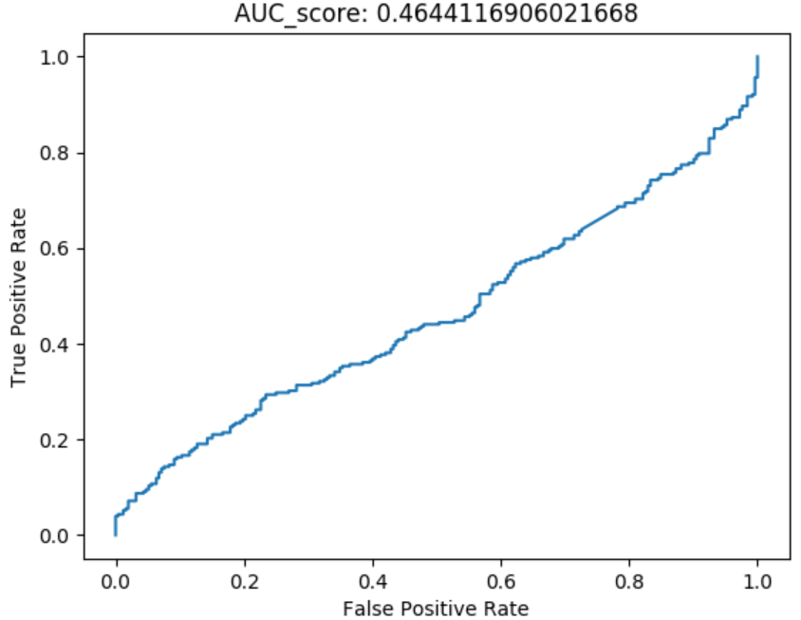
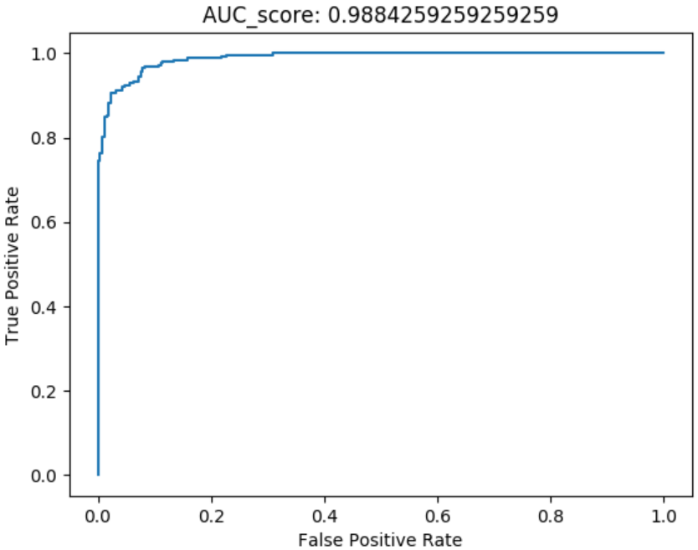
Image Quality Analysis Sequence = 100 Frame, Overlap = 10 Frame Test Positive: real Obama videos vs. Compressed real videos Test Negative: Generated fake videos with Obama mask vs. Compressed Fake Video Compression Method: Frame size reduced to ½ of original
Head wrt. Camera | Head Rotation | Gaze | Blink | Lips
FaceSwap Fake Videos for Obama
Compressed Fake Video for Obama ½ Frame Size

Slide 12
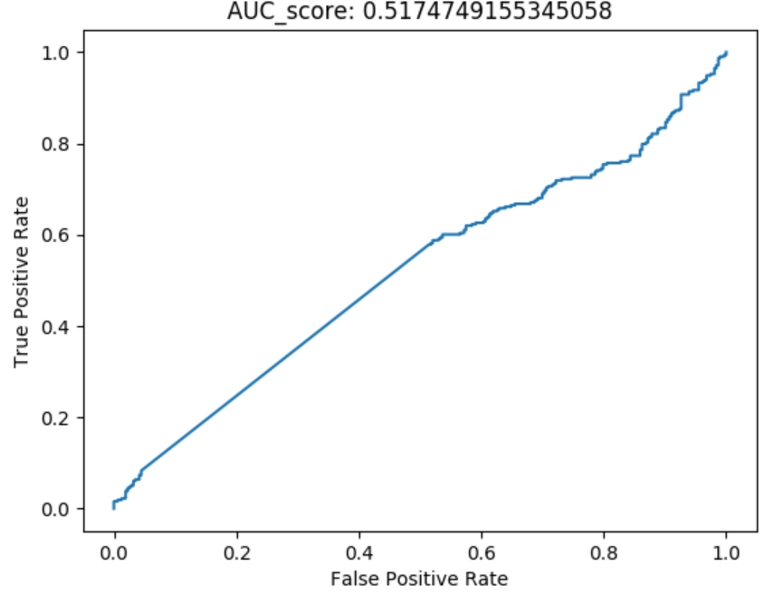
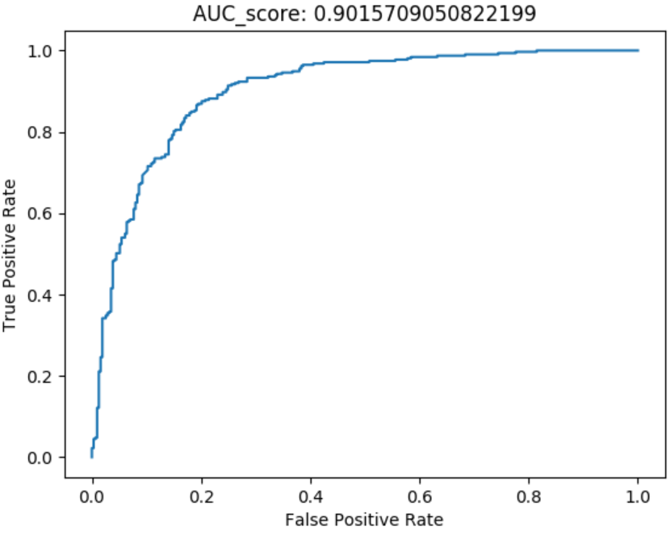
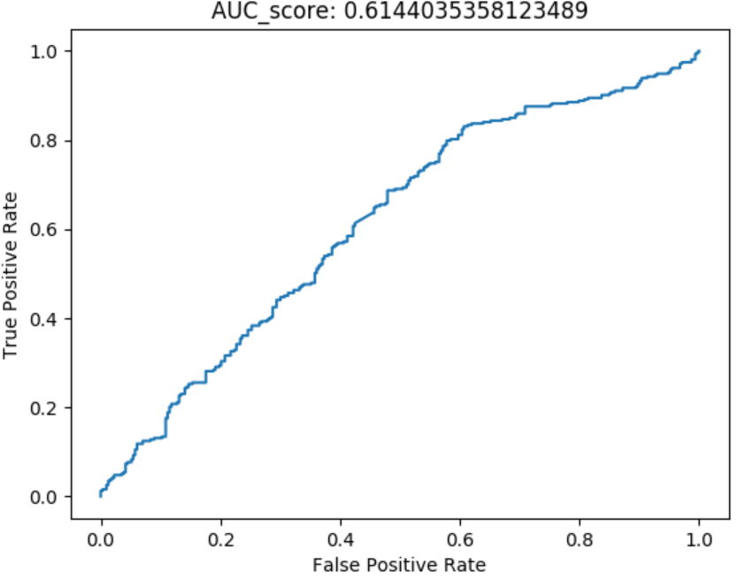
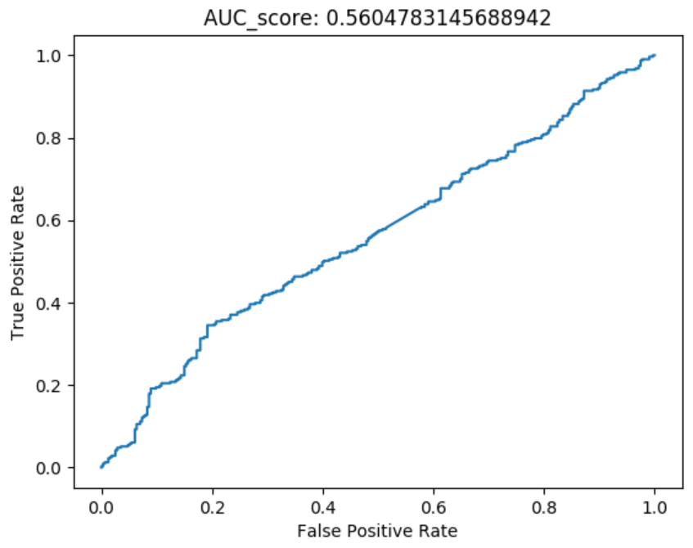

Image Quality Analysis Sequence = 100 Frame, Overlap = 10 Frame Test Positive: real Obama videos vs. Compressed real videos Test Negative: Generated fake videos with Obama mask vs. Compressed Fake Video Compression Method: Color reduction
Head wrt. Camera | Head Rotation | Gaze | Blink | Lips
FaceSwap Fake Videos for Obama
Compressed Fake Video for Obama Color Reduction

Slide 13
Image Quality Analysis 4 Compression Method Comparison
Head wrt. Camera | Head Rotation | Gaze | Blink | Lips
Bitrate
Frame Rate
Frame Size
Color

